Slide 1

Industrial Internship(ECE3099)
NAME : RAHUL MAHESH AWARI
REG.NO : 18BEC2014
TOPIC : Manufacturing of Infotainment System
COMPANY : Harman International,Pune

Slide 2

BUSINESS UNITS
Harman manufacturing involves both the hardware component production and highly-integrated digital cockpits,ADAS,cybersecurity and telematics control unit.
Harman International plant in Pune specializes in production of car audio systems and telematics control units.During the course of my internship I gained knowledge on how car audio systems are produced from scratch, right from Printed Circuit Board to fully functional audio system with features such as GPS navigation,Bluetooth etc.

Slide 3
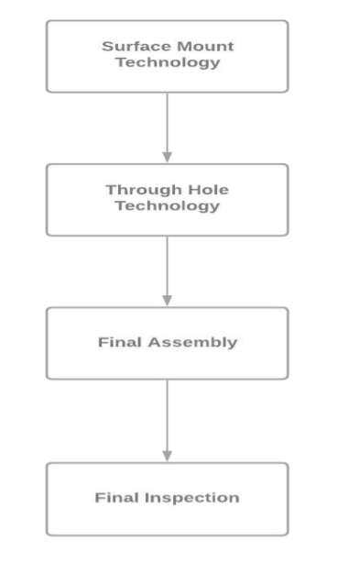
Steps Involved in Production
Surface Mount Technology:-Surface mount technology is the first step involved in the process.Surface Mount Technology is mainly used for insertion and soldering of smaller components onto the
PCB boards.
Through Hole Technology:-Through-hole technology refers to the mounting scheme used for electronic components that involves the use of leads on the components that are inserted into holes drilled in printed circuit boards (PCB) and soldered to pads on the opposite side either by manual assembly (hand placement) or by the use of automated insertion mount machines.

Slide 4
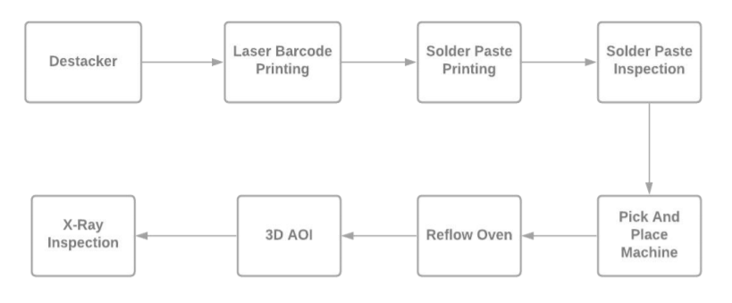
SURFACE MOUNT TECHNOLOGY
Destacker:-This Process Involves automated feeding of the Printed circuits boards to the conveyor belt and is the first step of this process.
Laser Barcode Etching:-2D barcode is etched onto the printed circuits boards after they are passed from destacker to laser etching machine.For Keeping Track of PCB boards.
Solder Paste Inspection:-This process involves a automatic paste dispensing machine.It consists of auto stencil where a brush wipes the stencils at regular frequency.But the most popular and widely used composition and ratio is the Ratio 96.5% Tin + 3.0% Silver and 0.5% Copper.

Slide 5
SURFACE MOUNT TECHNOLOGY
Solder Paste Inspection:-This process makes use of 3D camera’s which produce clear 3D images.Unlike the traditional cameras, 3D cameras are capable of capturing the height of the solder paste printed.The camera captures and checks for proper deposition on parameters such as height and volume.
Pick And Place:-This is the process in which components are placed over the board just before entering the soldering process.Only smaller components such as small IC,resistor are placed on the solder pasted board.Before placing of the components component feeder is calibrated and checked for accuracy.
Reflow Oven:-This Is the process where components are soldered onto the board.This station comprises of 13 heating zones and 1 cooling zone.The temperature in the oven increases gradually from low to high . The maximum temperature was 290 and minimum was approximately 103.
3D AOI Inspection:-This method is used for detecting soldering defects.This machine is equipped with 3D camera which is used by the operator for inspection of the soldered components.It even includes X-Ray inspection for advance inspection.

Slide 6
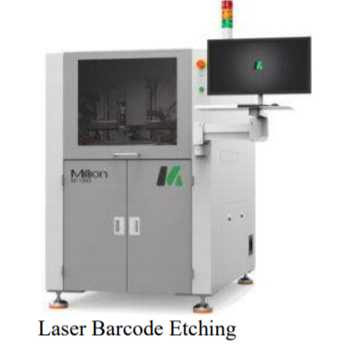
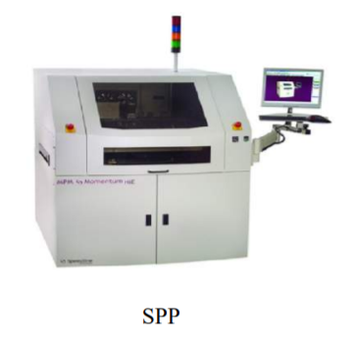
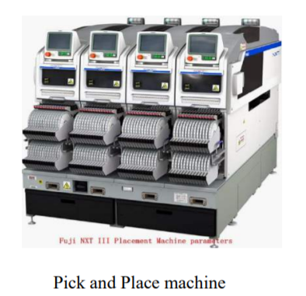
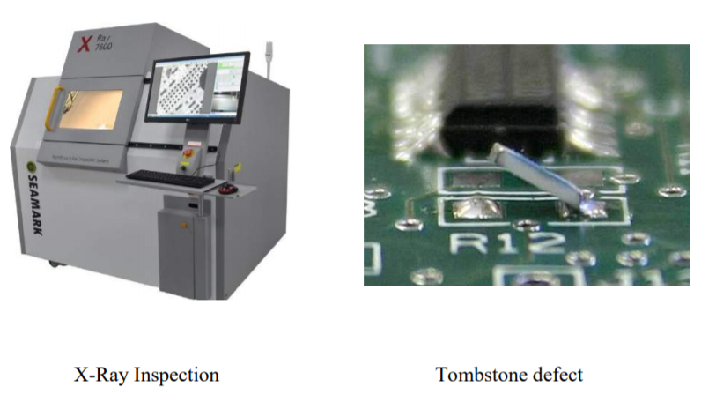
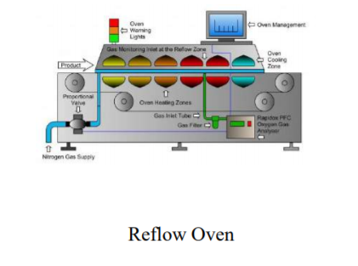
SURFACE MOUNT TECHNOLOGY
→
→
↓
←

